Slide 1






MALL CUSTOMER PREDICTION

Slide 2

ABSTRACT
The Mall Customer Prediction project uses clustering techniques to analyze customer demographics and shopping behavior. By segmenting customers into distinct groups based on patterns like spending habits and income levels, the project provides actionable insights for targeted marketing and personalized experiences. This data-driven approach helps optimize customer engagement, improve retention, and boost profitability for mall businesses.

Slide 3

INTRODUCTION
Understanding customer behavior is critical for enhancing shopping experiences and driving business growth. The Mall Customer Prediction project leverages machine learning to analyze customer demographics and spending patterns, segmenting them into meaningful groups. This segmentation helps mall management and retailers implement targeted marketing strategies, improve customer satisfaction, and optimize resources. By using data-driven techniques, the project provides valuable insights to create a more personalized and efficient shopping experience.

Slide 4

GOALS
1.
Customer Segmentation: Identify distinct customer groups based on demographics and shopping behavior.
2.
Targeted Marketing: Enable personalized campaigns to improve customer engagement and satisfaction.
Operational Optimization: Assist mall management in allocating resources efficiently based on customer insights.
3.
4.
Enhanced Customer Retention: Develop strategies to retain high-value customers by understanding their preferences.
5.
Profit Maximization: Drive increased profitability through data-driven decision-making and tailored offerings.

Slide 5
METHODOLOGY
Data Collection:
Use customer data with attributes like age, gender, annual income, and spending score.
Exploratory Data Analysis (EDA):
Analyze data distributions and correlations.
Visualize patterns using scatter plots, histograms, and pairplots.
Data Preprocessing:
Handle missing values and outliers to ensure clean data.
Normalize or scale numerical attributes for clustering.
Clustering Algorithm:
Apply K-Means Clustering to segment customers into groups based on their attributes.
Use the Elbow Method to determine the optimal number of clusters.
Model Evaluation:
Validate clusters using metrics like silhouette scores.
Interpret clusters to understand customer behaviors and preferences.
Insights and Actionable Strategies:
Identify characteristics of each cluster (e.g., high spenders, budget shoppers).
Develop strategies for targeted marketing and operational planning.

Slide 6
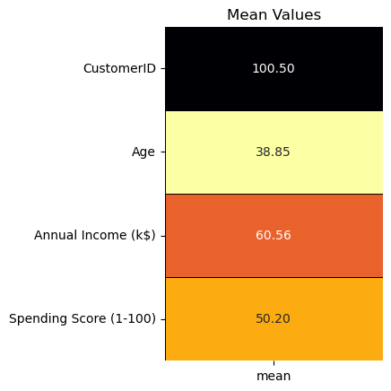
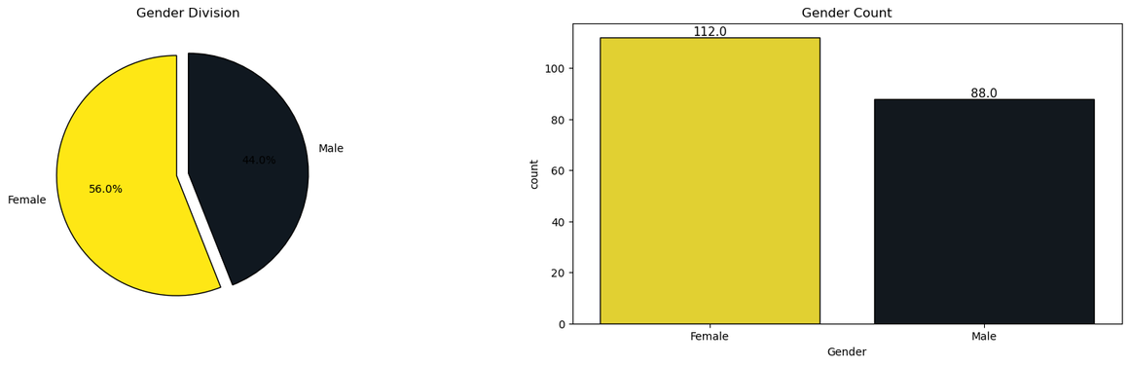
RESULT
Scatter Plots:
Revealed distinct groups of customers based on spending score and annual income.
Highlighted trends such as higher spending scores among mid-to-high income groups.
Pairplots:
Showed clear relationships between variables, such as age and spending score.
Identified potential clusters visually.

Slide 7
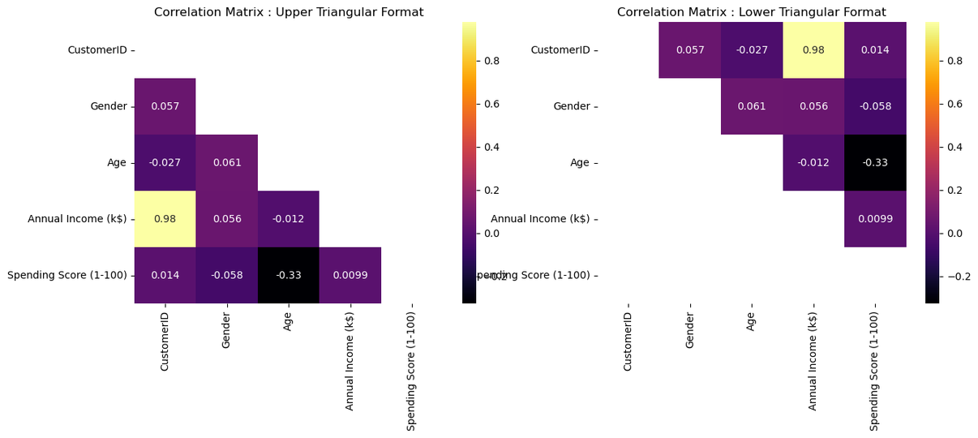
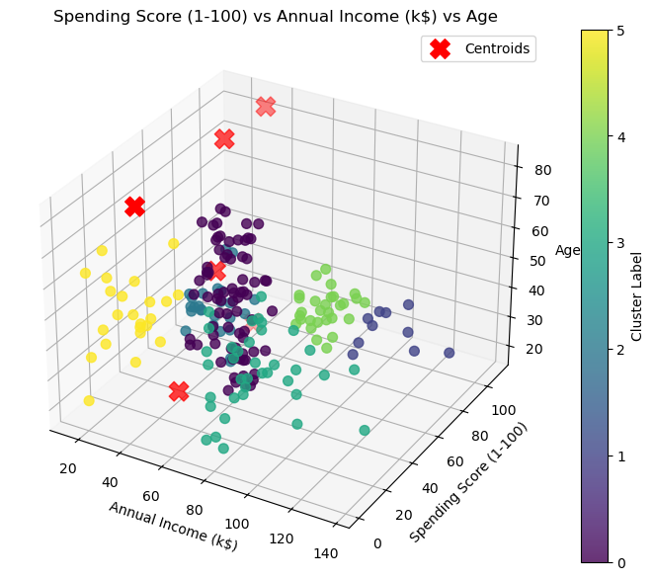
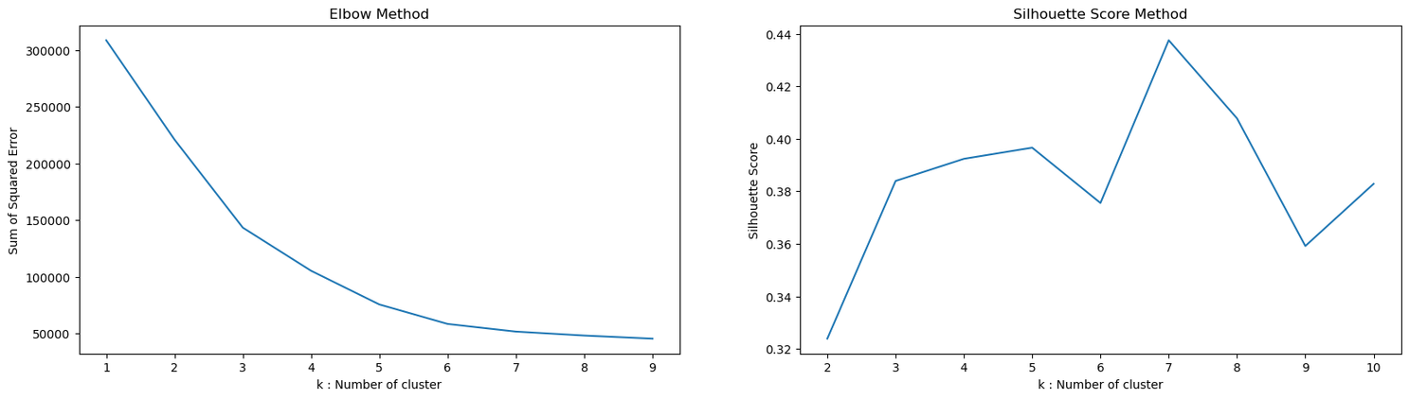
RESULT
Cluster Visualization:
Final clusters displayed customer segments, such as high-income high-spenders and budget-conscious low-spenders.
Allowed clear differentiation between customer groups for actionable insights.

Slide 8
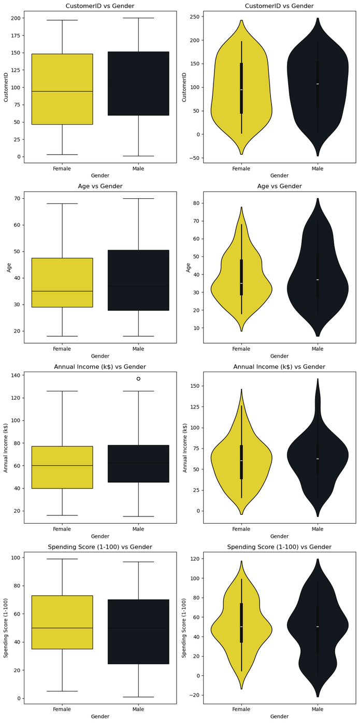
RESULT
Elbow Method Plot:
Demonstrated that the optimal number of clusters for K-Means is around 4-5.
Helped refine the clustering process for meaningful segmentation.

Slide 9
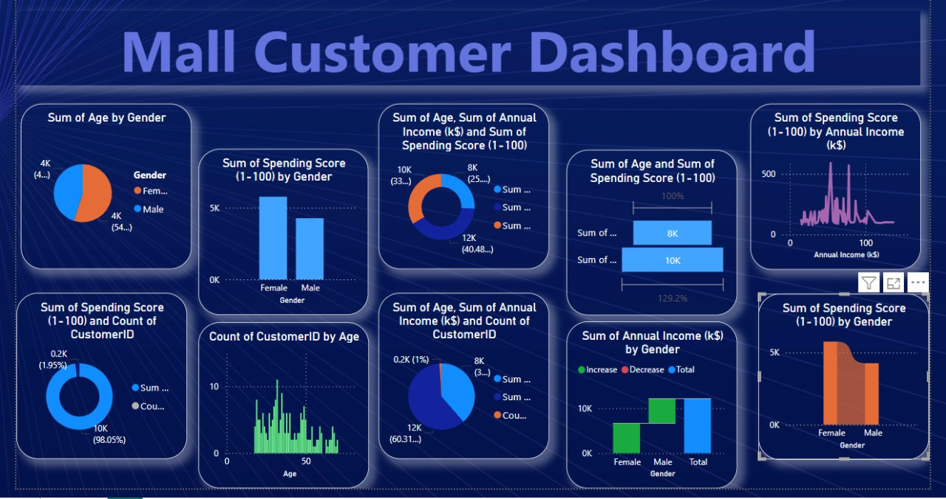

Slide 10
CONCLUSION
The Mall Customer Prediction project successfully segmented customers into distinct groups using clustering techniques. Insights from the analysis revealed meaningful patterns in spending behavior and demographics, enabling targeted marketing and operational improvements. By leveraging data-driven strategies, the project enhances customer engagement, optimizes resource allocation, and boosts mall profitability. This approach demonstrates the value of understanding customer behavior to deliver personalized and impactful shopping experiences.

Slide 11

THANK
you

